Slide 1
DSA 210 Term Project
World Bank Development Index & Happiness
Name: Utku Genc
SuID: 30611

Slide 2
Outline
Introduction
Data We Use
Global Trends
Top 30: When The Basic Needs Are Met
The Bottom 30: A noisy Picture
Interesting Anomalies
Hypothesis
Two ML Method Application
Linear Regression
Random forest
Results
Using Linear Regression And Random Forest Predictions on Hypothetical Country
Conclusion

Slide 3
Introduction
The World Happiness Report gives a “life evaluation” (happiness) score for many countries each year, based on survey answers. It also reports a few main drivers (like income, health, freedom, and trust). However, two problems remain:
We do not clearly see how much each factor matters compared to the others
There may be other important drivers that are not included in the report’s main set.
This project studies happiness from two angles. First, it measures how strongly different indicators move together with happiness across countries (using Pearson and Spearman correlations). Second, it checks whether these relationships change when we compare very happy countries (Top 30) versus the least happy countries (Bottom 30). This matters because “basic needs” may dominate in poorer settings, while “higher-level” social and political factors may matter more once a country is already developed.
Finally, two machine learning models are applied, Linear Regression and Random Forest, to test how well we can predict happiness from many indicators at once, and to identify which variables the models use most.

Slide 4
Data We Use
This study combines two datasets:
World Happiness Report (WHR) data: The WHR provides country level happiness measures based on the Gallup World Poll. The key target variable in analysis is the average life evaluation score (“Life_Evaluation_Avg”). The WHR data is available through the report’s official data sharing page.
World Bank World Development Indicators (WDI) dataset: This dataset includes many country indicators across the economy, society, environment, and governance. Examples used in the analysis include life expectancy, internet use, access to electricity, fertility/birth rate, education spending, CO₂ emissions, government effectiveness, rule of law, and control of corruption. It is based on indicators extracted from the World Bank database and shared as a structured Kaggle dataset.
After merging, focus is on numeric columns, handle missing values by filling with column averages, and compare patterns globally and within the Top 30 / Bottom 30 groups.

Slide 5
Global Trends
Across all countries, the strongest story is “basic development first.” Variables linked to health, infrastructure, and human capital show the highest correlations with happiness.
The top global relationships in the output include life expectancy (Pearson = 0.82), internet use (= 0.82), and the Human Capital Index (= 0.81). Access to electricity is also very strong (Pearson = 0.72; Spearman = 0.81). Together, these suggest that when a country improves core living conditions, health, skills, and basic services, happiness rises in a clear and steady way.
Governance quality is also highly related to happiness. Government effectiveness (= 0.78), regulatory quality (= 0.74), rule of law (= 0.73), and control of corruption (= 0.71) all show strong positive relationships. In simple terms: people tend to be happier where institutions work.
One notable negative driver is birth rate (Pearson = -0.73). Countries with lower birth rates tend to have higher happiness scores. This often connects to education, women’s participation in the workforce, and higher household stability.
These are correlations, not proof of causation, but they provide a strong “big picture” map of happiness drivers.

Slide 6
Top 30: When The Basic Needs Are Met
When we look only at the Top 30 happiest countries, the pattern changes. Many “basic needs” variables lose strength because they are already high and do not vary much. For example, electricity access becomes less informative (Pearson = 0.31) compared to the global result.
Instead, the strongest relationships shift toward rights, trust, and institutional quality. The best predictor in this group is voice and accountability (Pearson = 0.66; Spearman = 0.79). This suggests that in highly developed countries, differences in freedom of speech, democratic participation, and accountability become major separators between “happy” and “very happy.”
Governance indicators remain very strong: rule of law (Pearson = 0.68), control of corruption (= 0.64), government effectiveness (= 0.60), and regulatory quality (= 0.63). Also, education spending becomes clearer here (government expenditure on education Pearson = 0.66), even though it was weaker globally.
An interesting shift appears in energy: renewable energy consumption is negative globally, but turns positive in the Top 30 (Pearson = 0.39). A possible explanation is that richer countries can afford green transitions, and people may value them more once daily survival problems are solved.

Slide 7
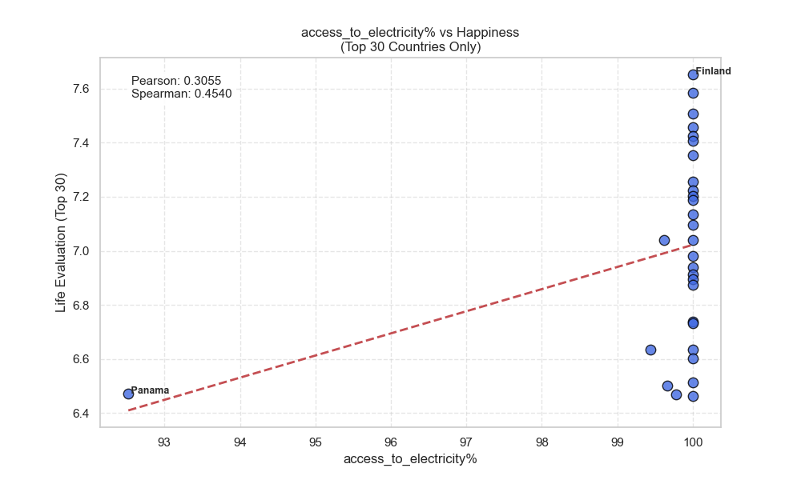
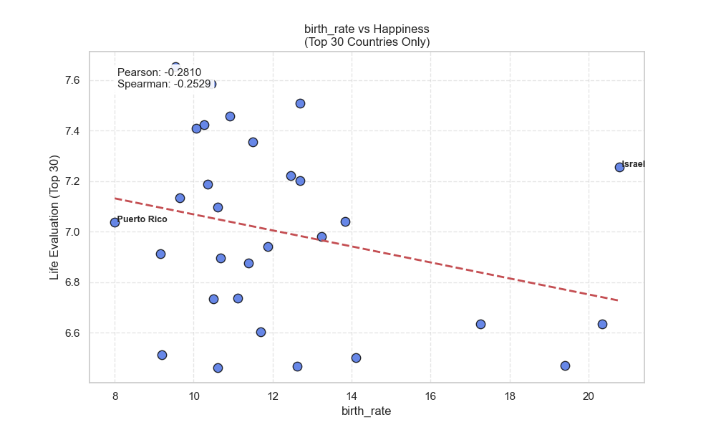
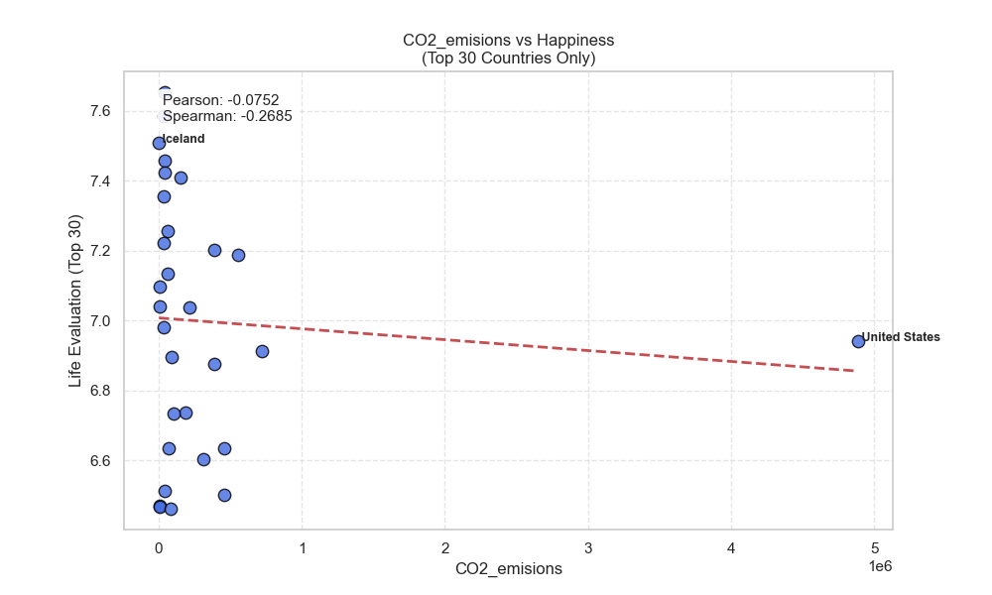
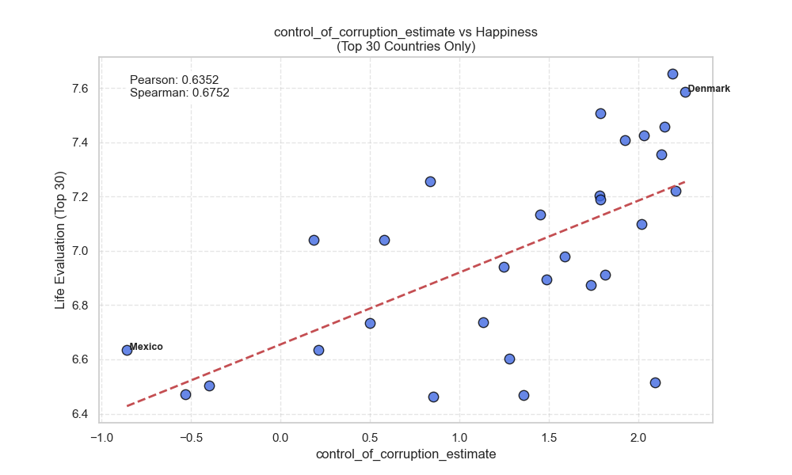
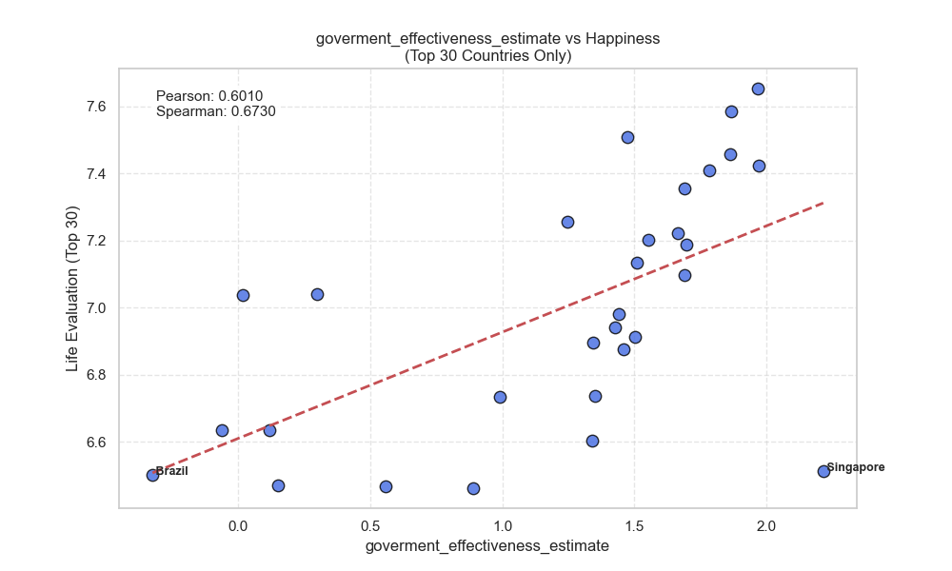
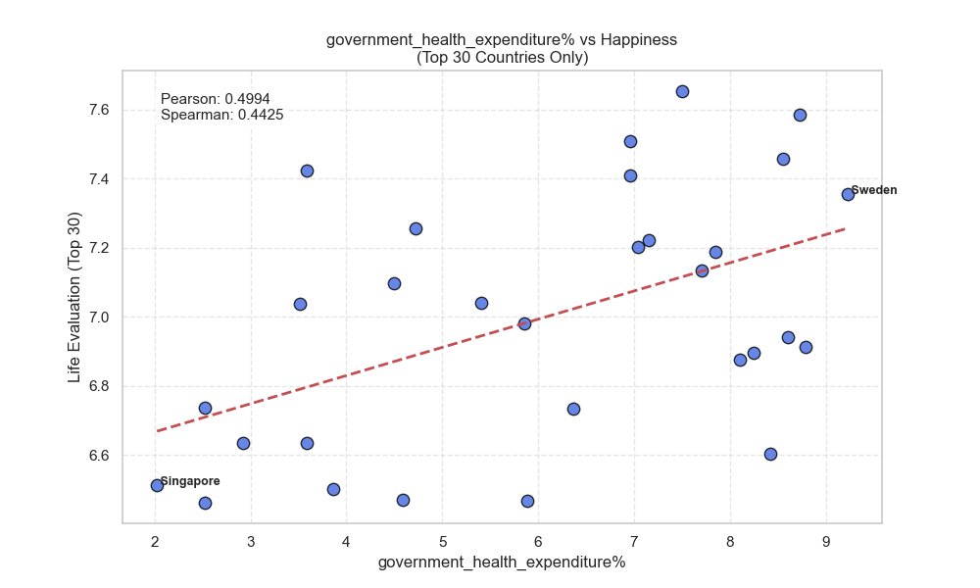
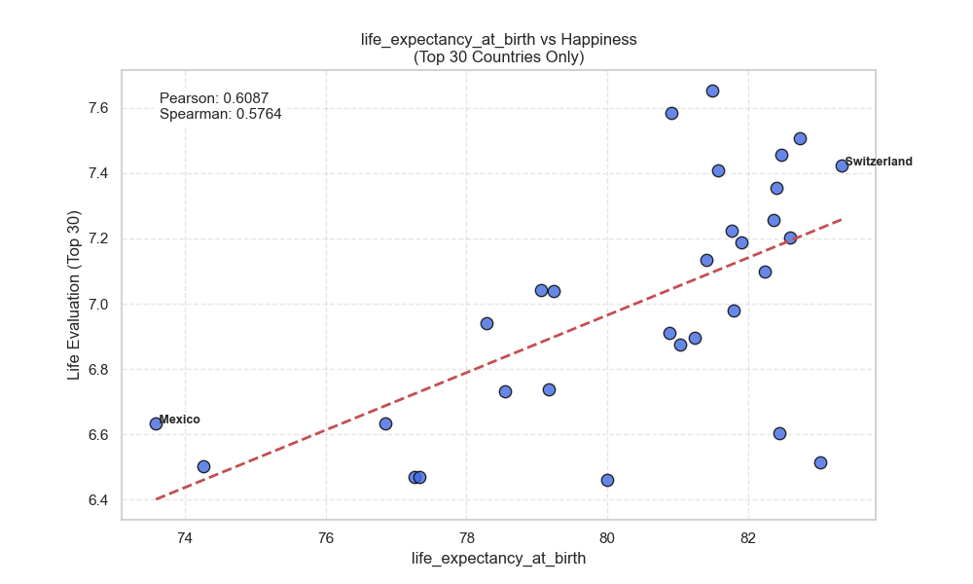
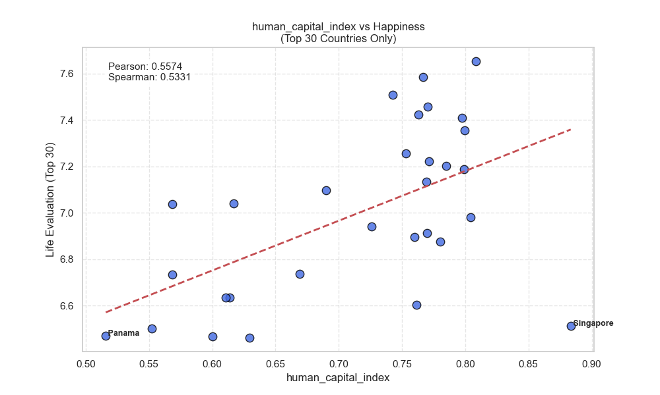
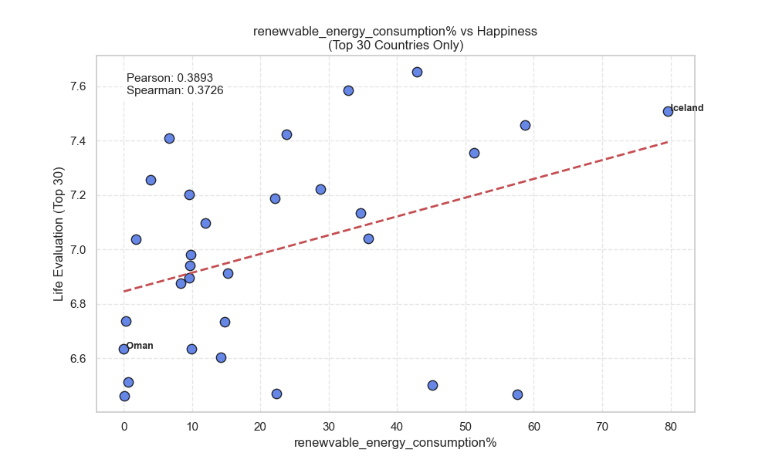
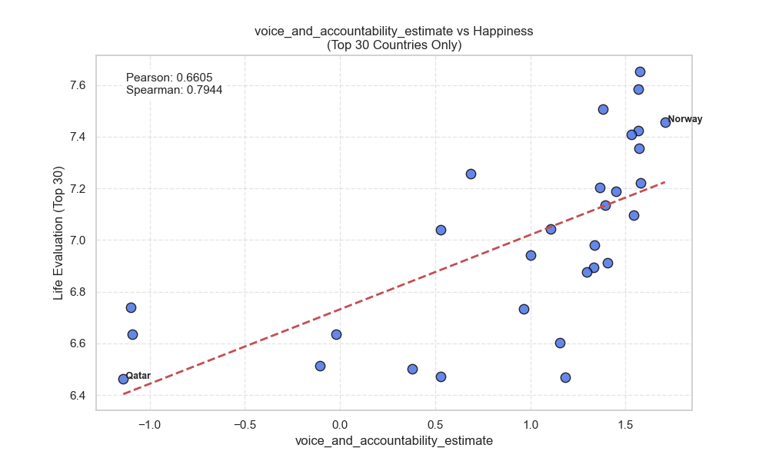
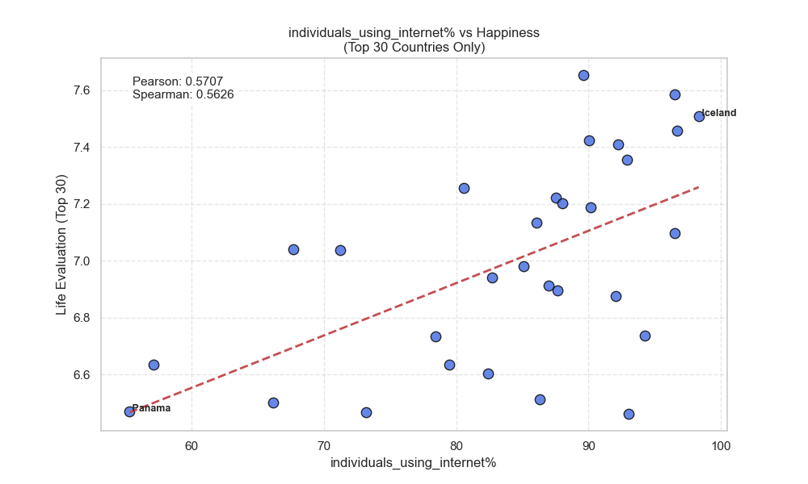

Slide 8
The Bottom 30: A noisy Picture
For the Bottom 30 countries, relationships become weaker and less stable. Many variables that were strong globally, like electricity, internet access, life expectancy, and human capital, drop to low or moderate correlations. This suggests that in very difficult settings, happiness is shaped by factors that standard development indicators do not capture well.
In the results, only a few variables keep a noticeable relationship. GDP (current USD) shows a modest positive correlation (Pearson = 0.13; Spearman = 0.42). CO₂ emissions also show a moderate Spearman correlation (= 0.44). This likely does not mean pollution makes people happier, more likely, CO₂ is acting as a proxy for industrial activity and income.
Rule of law remains one of the few governance indicators that still relates to happiness (Pearson = 0.34). This fits the idea that basic safety and predictable rules matter strongly when conditions are unstable.
Overall, the “noisy” picture supports a key limitation: for low happiness countries, major drivers may include war, conflict, sudden economic shocks, insecurity, or political violence, variables that are not directly included in the WDI set that is used. In other words, the model is missing some of the most important realities on the ground.

Slide 9
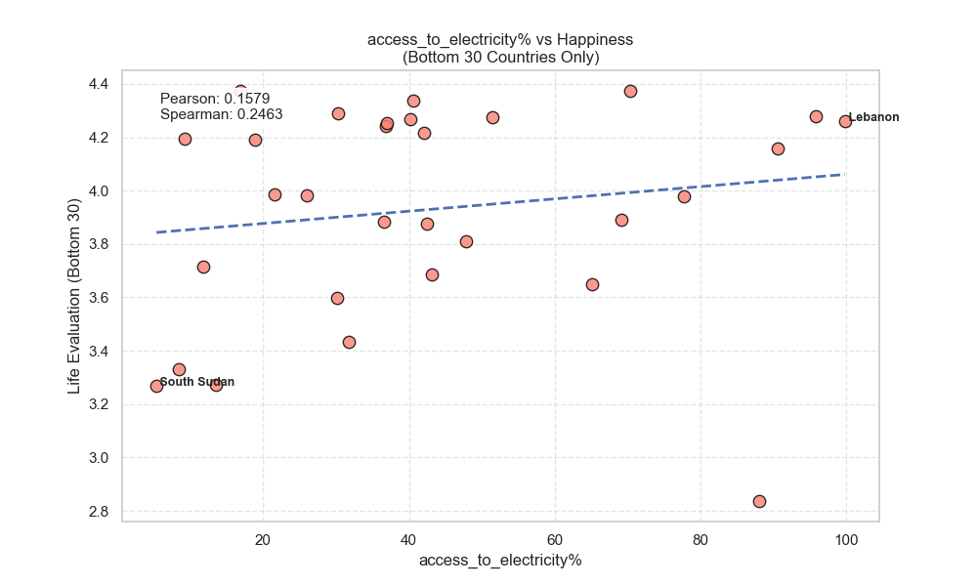
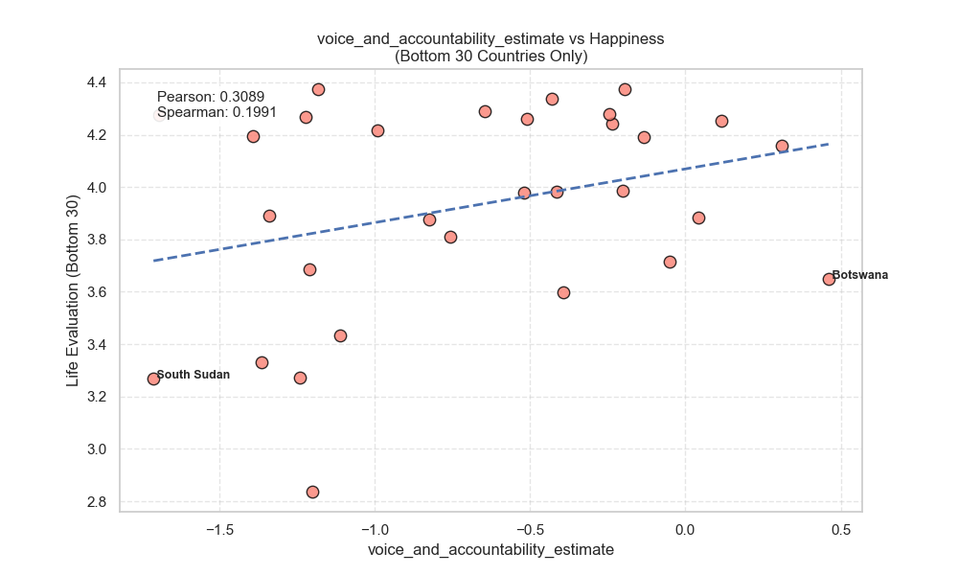
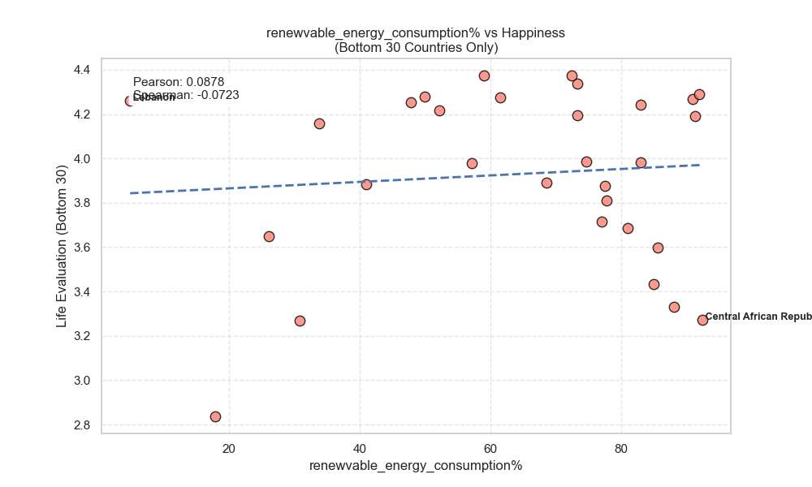
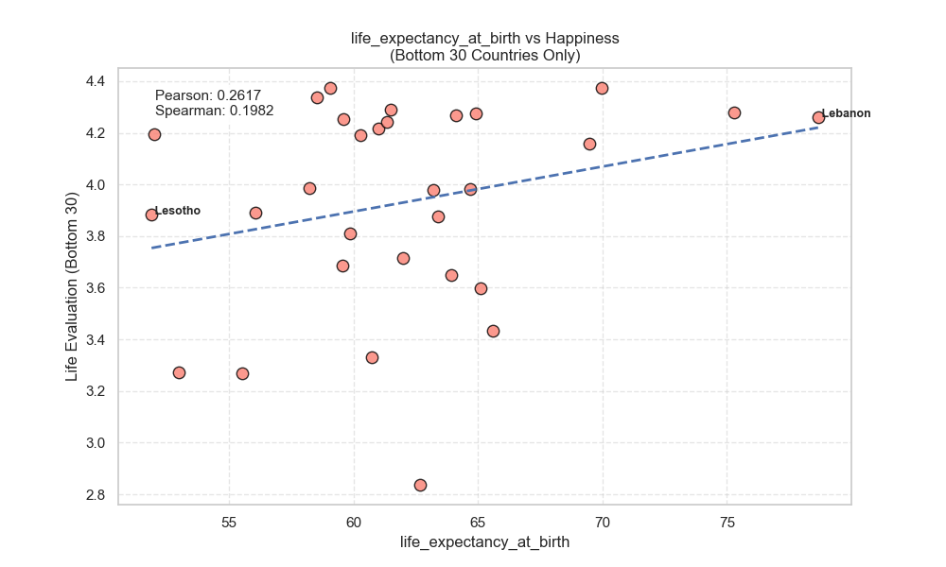
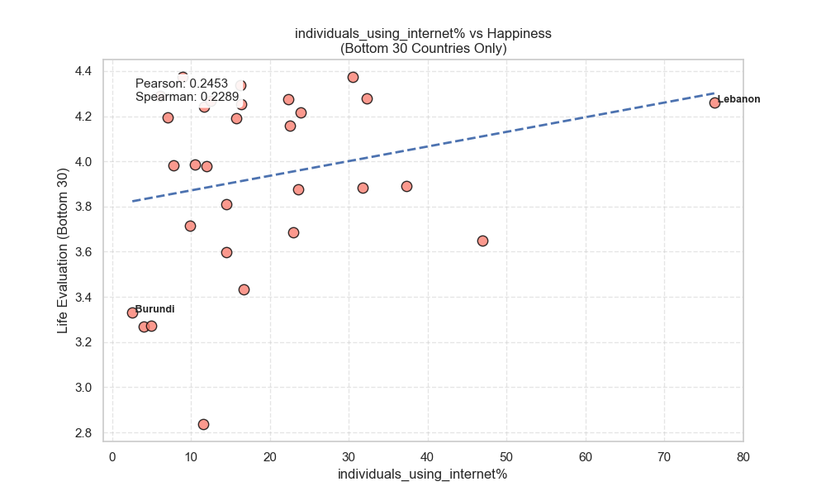
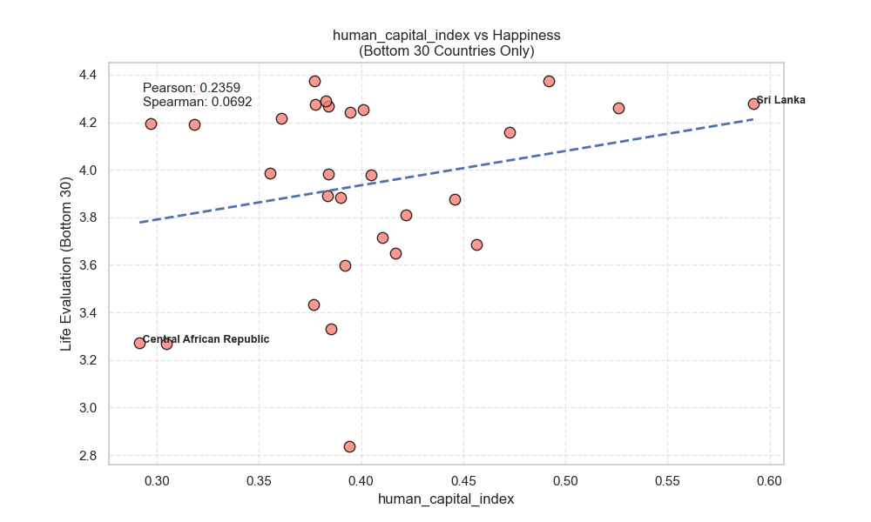
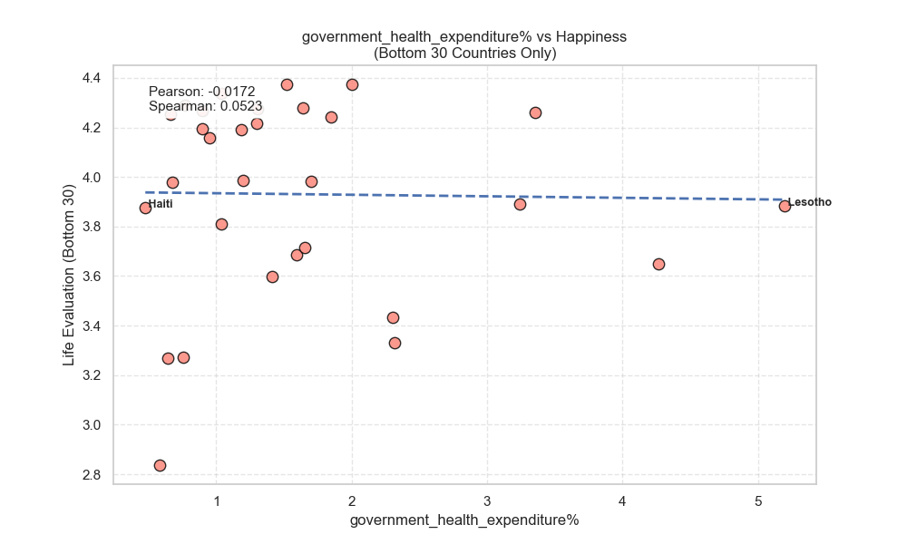
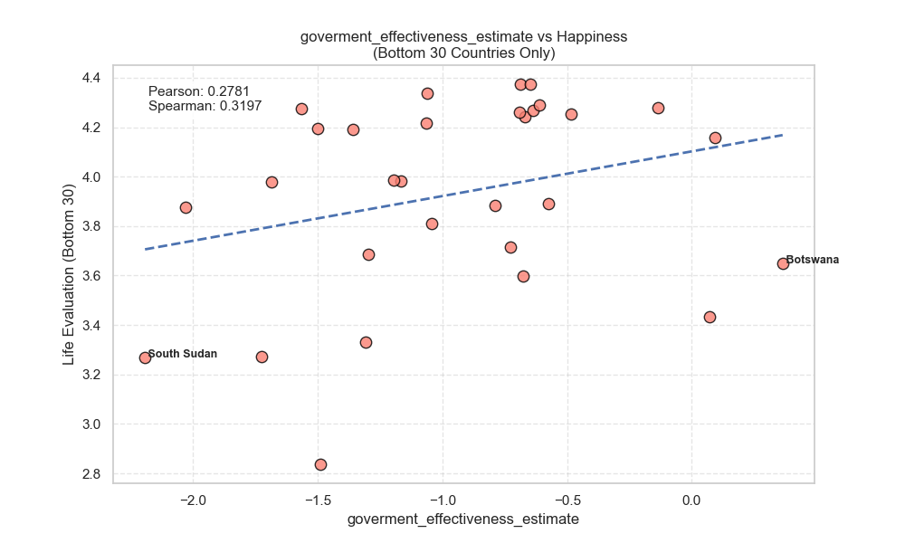
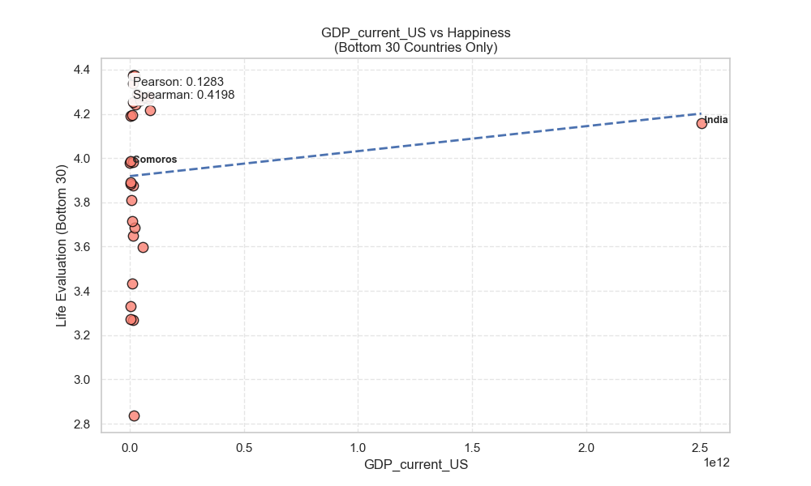
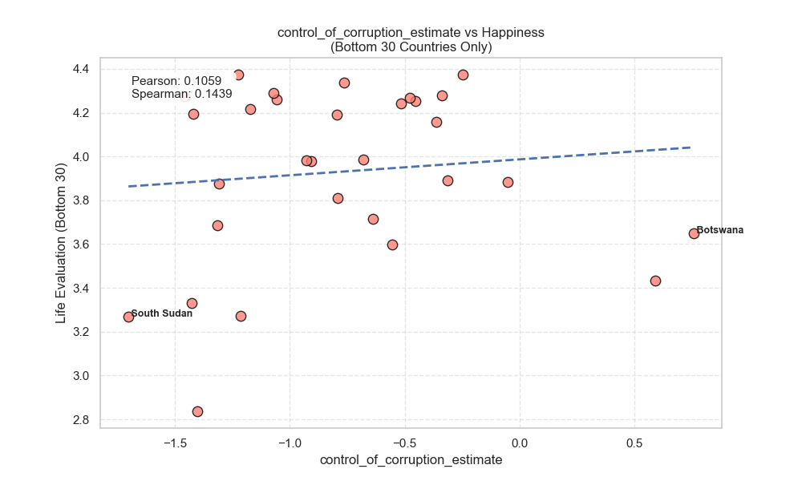
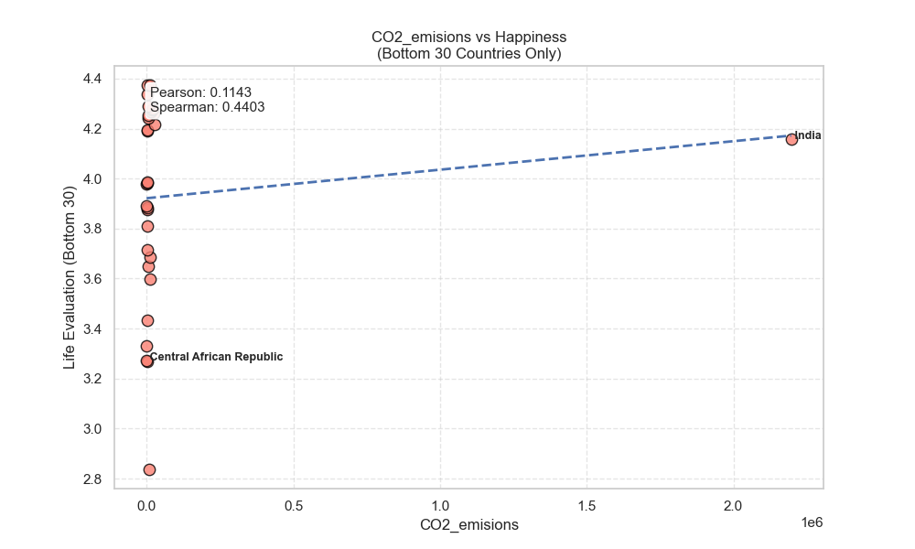
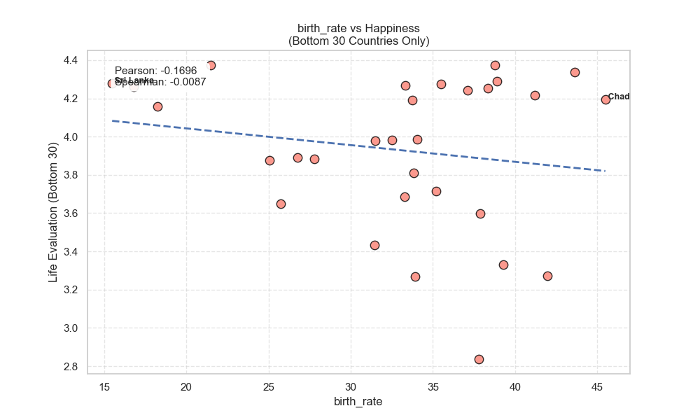

Slide 10
Interesting Anomalies
Two patterns stand out as “weird but informative.”
CO₂ emissions: big Pearson - Spearman gap (global).
Globally, CO₂ emissions have a very low Pearson correlation (= 0.08) but a much higher Spearman correlation (= 0.51). This means the relationship is not cleanly linear, but the ranking still matters: countries with more emissions often rank higher in happiness, up to a point. A few extreme countries can distort the linear trend (classic outlier behavior). This is why checking both Pearson (linear) and Spearman (rank-based) is useful.
Government health expenditure: strong globally, weaker in the Top 30.
Globally, government health expenditure is highly correlated with happiness (Pearson = 0.73). In the Top 30, it drops (= 0.50). A simple interpretation: once a country already has a strong health system, spending more does not guarantee higher happiness. The effect may “saturate” meaning extra investment gives smaller returns in life evaluation.
A smaller anomaly is renewable energy switching sign: negative globally (= -0.52) but positive in the Top 30 (= 0.39). This may reflect development stages: poorer countries may rely on renewables due to lack of infrastructure, while richer countries choose renewables as a policy preference.

Slide 11
Hypothesis
“Structural indicators (GDP, Electricity, Internet Access) are strong predictors of happiness in developing nations (Bottom 30), but their predictive power diminishes significantly in developed nations (Top 30), where “soft” factors (Freedom, Trust, Generosity) become the primary differentiators.”
This hypothesis matches the intuition of “needs first, values later.” In low happiness settings, access to basics like stable income, electricity, healthcare capacity, and connectivity should matter more because these are not guaranteed. In high happiness settings, these basics are already close to universal, so they cannot explain much variation. Instead, differences in governance quality, freedom, fairness, and trust may become the main reasons why one developed country is happier than another.
My correlation results partly support this: globally, structural and human development indicators (life expectancy, internet use, electricity, human capital) are extremely strong. In the Top 30, the strongest signals shift toward voice and accountability and corruption control, while electricity becomes weak. In the Bottom 30, correlations are messy, which suggests the hypothesis may be true in spirit, but difficult to prove with these variables alone, because major missing factors (conflict, instability, safety) may dominate the happiness scores.
The ML models are used next to test whether this pattern holds when many variables are considered together.

Slide 12
Two ML Method Application
To go beyond pairwise correlations, I used two machine learning models to predict Life_Evaluation_Avg from many development indicators at the same time.
Data setup: I selected numeric features, filled missing values with column means, and split the dataset into training (80%) and testing (20%). In my run, this produced 117 countries for training and 30 for testing. For Linear Regression, I standardized the features so coefficients can be compared more fairly.
Why two models?
Linear Regression is simple and interpretable, but it assumes a mostly linear relationship and can struggle with interactions (when the effect of one variable depends on another).
Random Forest can model non linear patterns and interactions automatically. It often performs better in complex social data, but it is less transparent than a simple linear equation.
I evaluated both models using R² (how much variance is explained) and RMSE (average prediction error size). I also examined “influential factors” using regression coefficients (Linear Regression) and feature importance (Random Forest).

Slide 13
Linear Regression
The Linear Regression model performed poorly on the test set: R² = -0.138 and RMSE = 1.15. A negative R² means the model is doing worse than a simple baseline that predicts the average happiness for every country. This suggests that happiness is not well explained by a single linear combination of these features, at least with this dataset and split.
The “top factors” based on coefficients also looked unstable and hard to trust. For example, the largest coefficients included other greenhouse emissions (positive) and CO₂ emissions (negative), plus population-related variables. These signs can happen when features overlap strongly (multicollinearity), when relationships are non-linear, or when outliers influence the fit. Even though I scaled the data, coefficient size does not automatically mean true importance if predictors are correlated with each other.
So, the key takeaway is not that “emissions cause happiness changes,” but that the linear model struggles to capture the real structure of the data. Happiness likely depends on non-linear effects (thresholds, saturation) and interactions (for example: internet access matters more when basic infrastructure exists). This limitation is exactly why a more flexible model is useful.

Slide 14
Random forest
The Random Forest model performed much better: R² = 0.696 and RMSE = 0.595. This means it explains a large part of the variation in happiness scores and predicts with a noticeably smaller average error than Linear Regression.
Why the improvement? Random Forest can capture patterns that are common in real world development data:
Non-linear effects: for example, improving electricity access from 50% to 80% may matter more than improving from 98% to 100%.
Interactions: the impact of internet use might depend on education levels, income, or political stability.
Robustness: using many decision trees reduces sensitivity to noise in any single indicator.
I also saved a feature importance plot. Feature importance in Random Forest does not prove causality, but it helps identify which indicators the model uses most when predicting happiness.
One caution: Random Forest can sometimes “learn” proxies (like CO₂ acting as a proxy for industry and GDP). So interpretation should be careful and supported by the earlier correlation analysis and by real world reasoning.
Overall, Random Forest appears to be a better fit for this problem because happiness is complex, multi factor, and rarely purely linear.

Slide 15
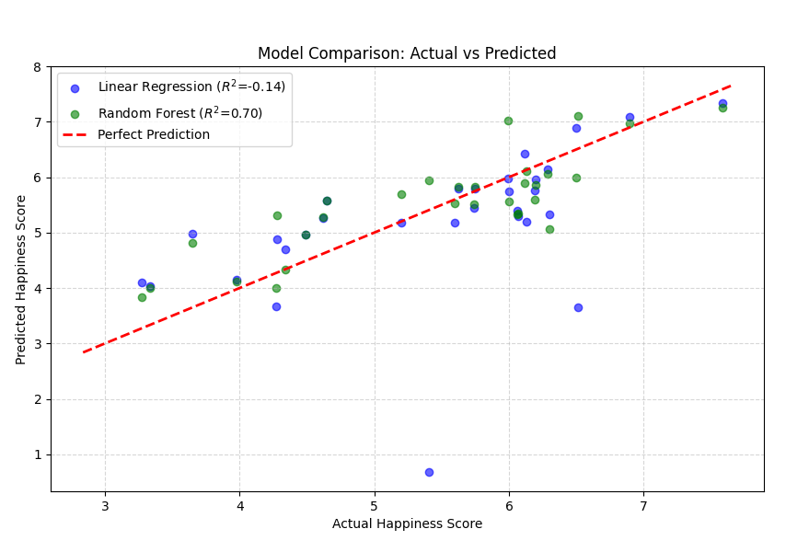
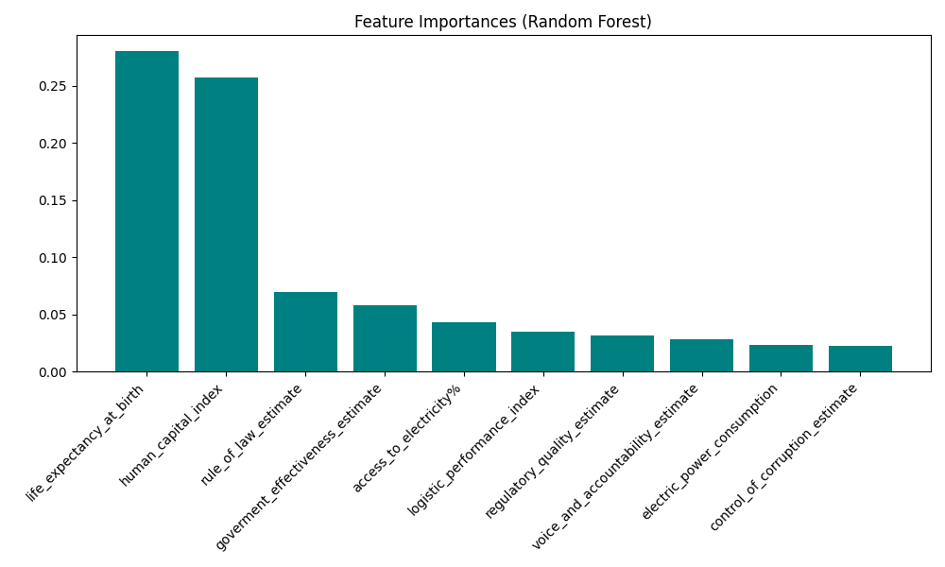
Results

Slide 16
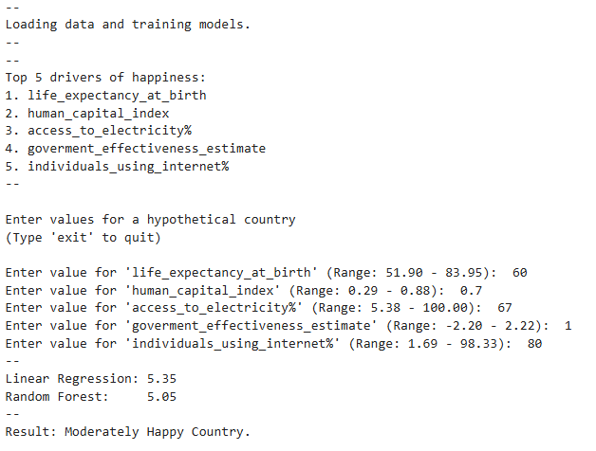
Using Linear Regression And Random Forest Predictions on Hypothetical Country

Slide 17
Conclusion
This project explores what drives national happiness using two steps: correlation analysis (global, Top 30, Bottom 30) and machine learning prediction.
The global results are clear: happiness strongly rises with core development outcomes, life expectancy, internet use, human capital, and electricity access, and with strong institutions like government effectiveness and rule of law. In the Top 30 happiest countries, the story shifts. Basic needs matter less because they are already met, and “higher-level” factors like voice and accountability and corruption control become stronger separators.
For the Bottom 30, patterns become weak and noisy. This likely means the key drivers in these countries include missing variables such as conflict, insecurity, and political crises. Standard development indicators alone may not describe everyday reality well enough to predict happiness there.
The ML results reinforce this complexity. Linear Regression failed (negative R²), which suggests happiness is not well captured by a simple linear formula. Random Forest performed strongly (R² = 0.70), supporting the idea that happiness depends on non linear relationships and interactions between indicators.
Overall, the findings support the main hypothesis directionally: once basic needs are satisfied, “soft” governance and rights factors play a bigger role. The next step is to formalize results and add variables that capture instability and safety more directly.

